Slide 1
A GRAPHICAL PASSWORD AUTHENTICATION IN SECURE STORAGE SYSTEM
PRESENTED BY
JAYALAKSHMI S
2019202018
MCA R(3 YEAR)
GUIDE: Mr.H.Riasudheen

Slide 2
OVERALL ARCHITECTURE

Slide 3
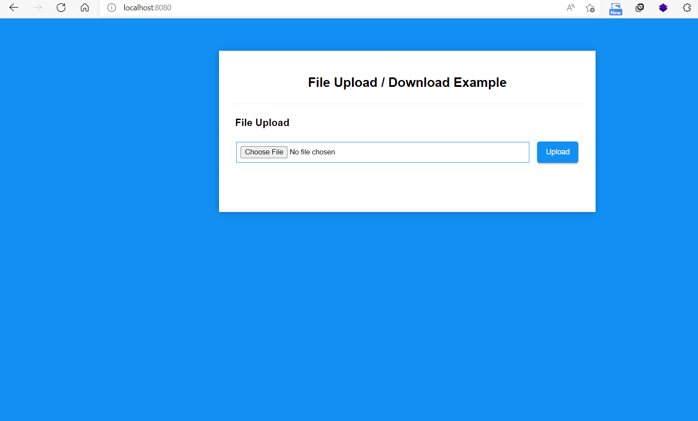
FIRST REVIEW OUTPUT SCREEN SHOTS

Slide 4
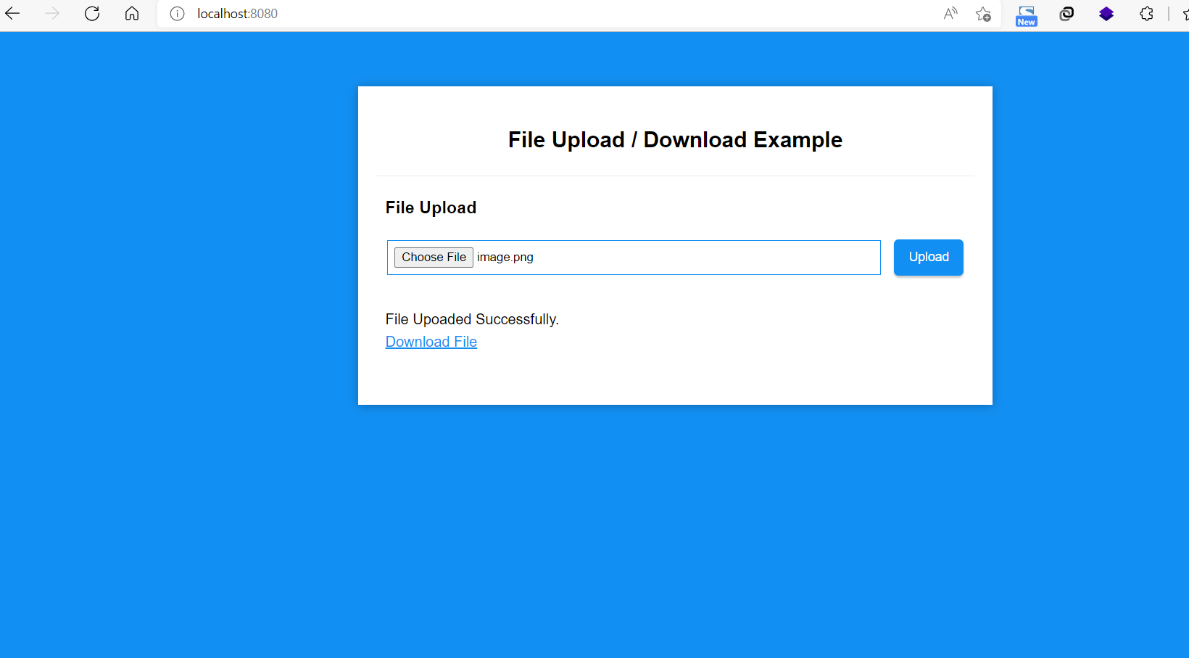

Slide 5
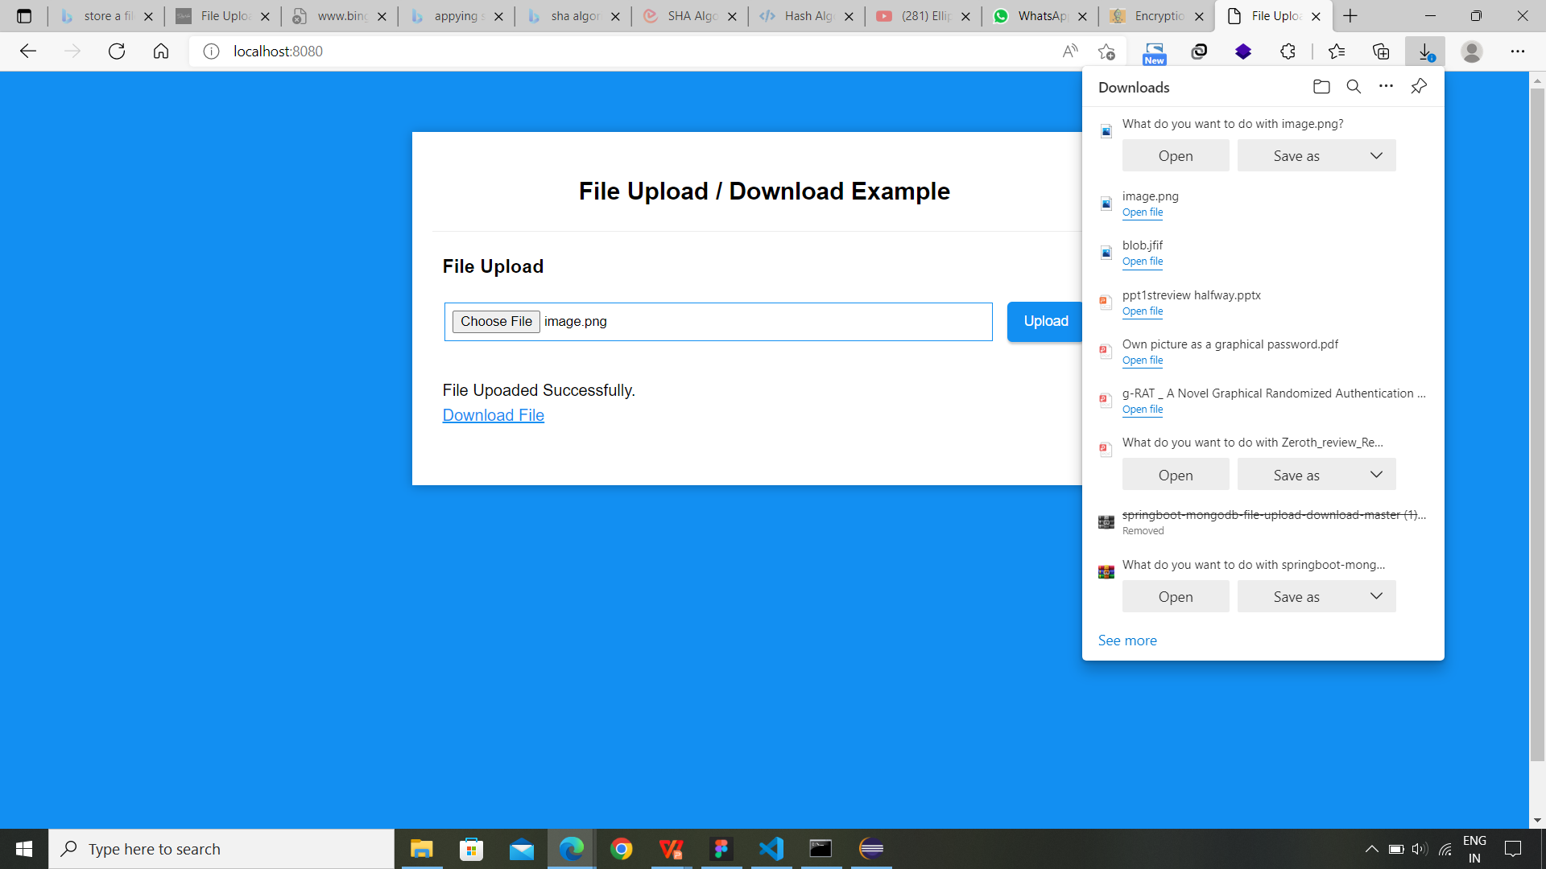

Slide 6
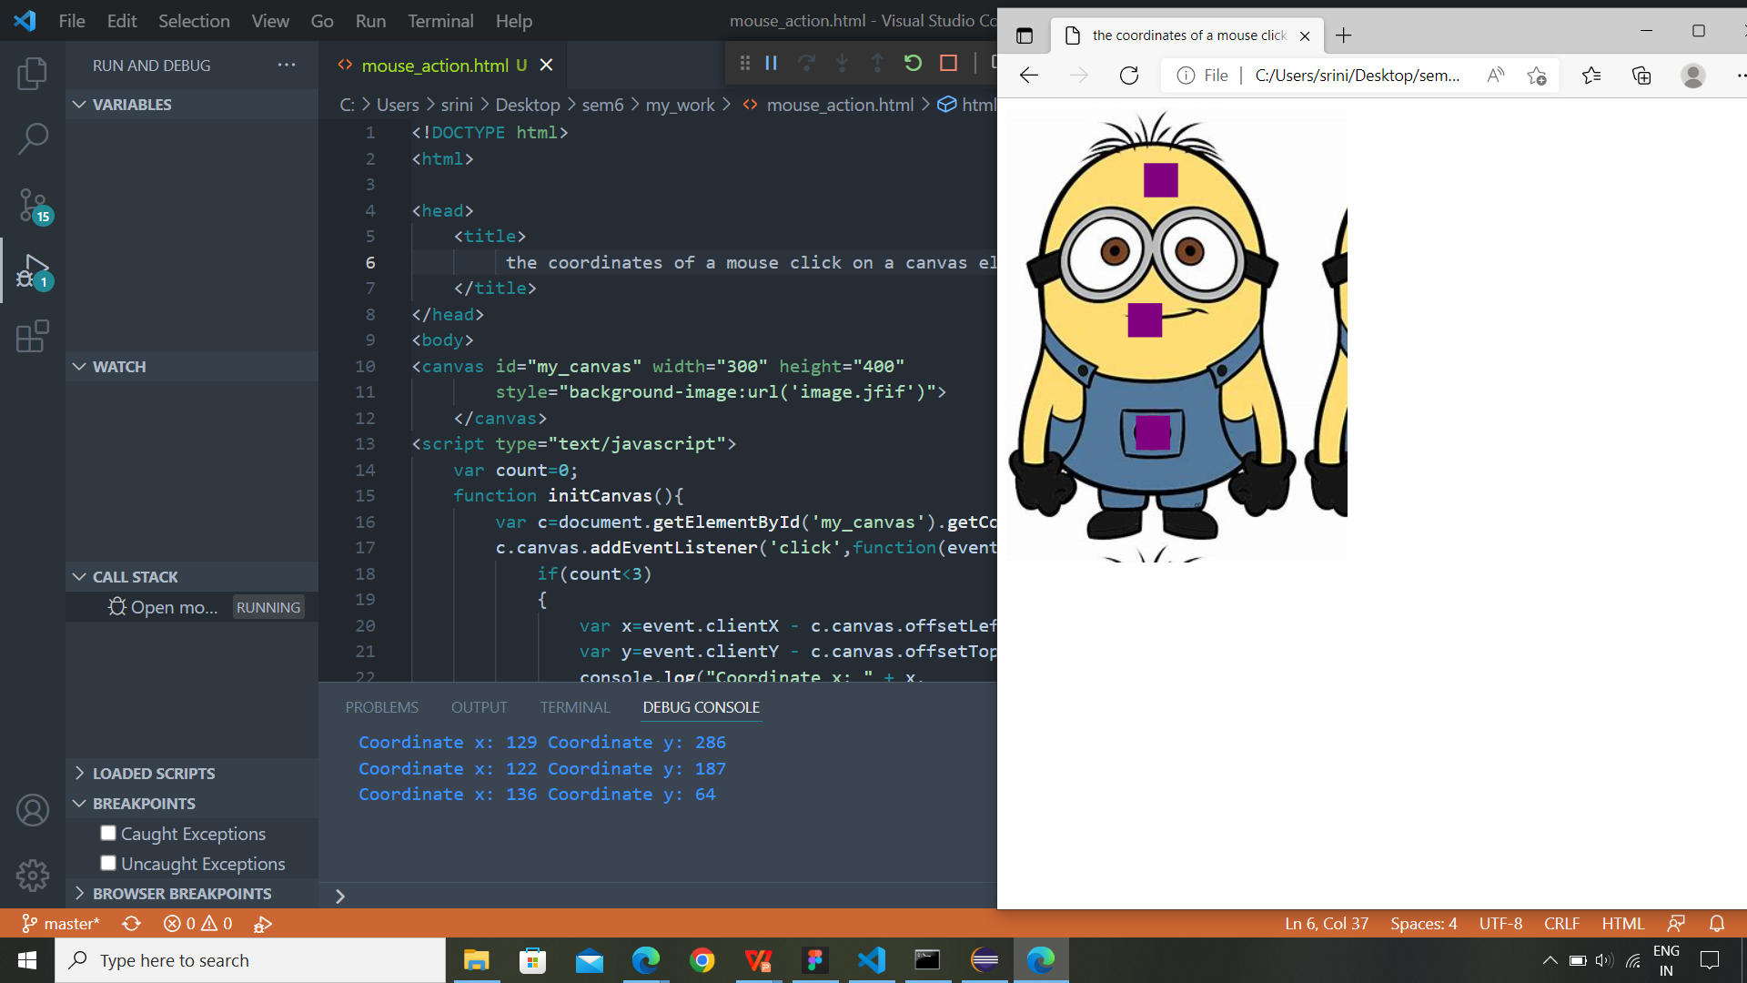
LOCATE THE CO-ORDINATES

Slide 7
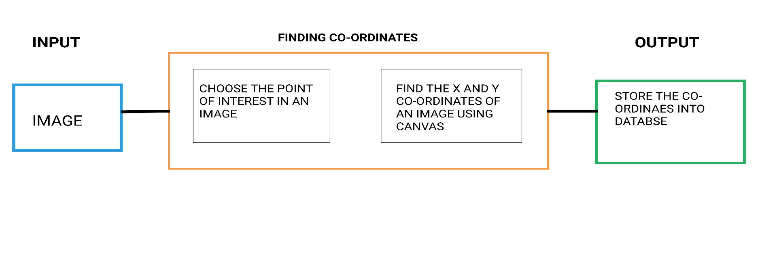
LIST OF MODULES
SET PASSWORD
An image is loaded from the local storage. In that image user wishes to click the 5 points of interest.
All the point co-ordinates are fetched and stored in mongo database

Slide 8
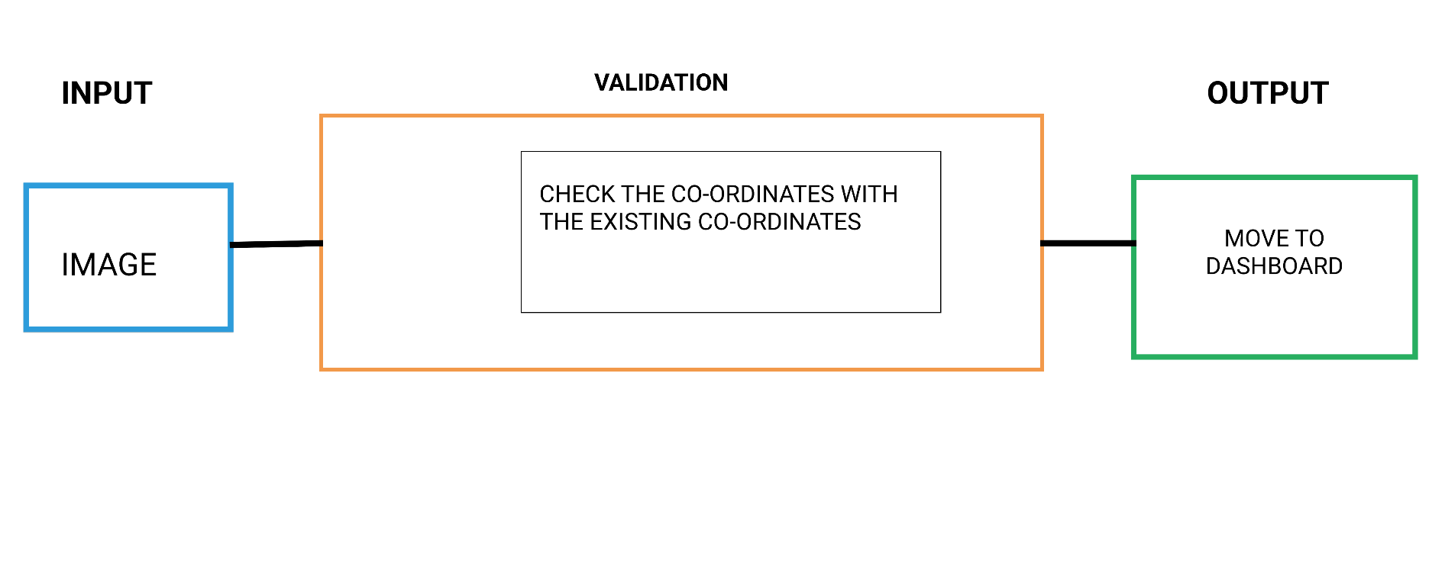
LOGIN
Enter the user’s email id
Fetch the image from database which is stored in binary format
Select the pixels which is already selected in register module
If the password is valid enter into dashboard

Slide 9
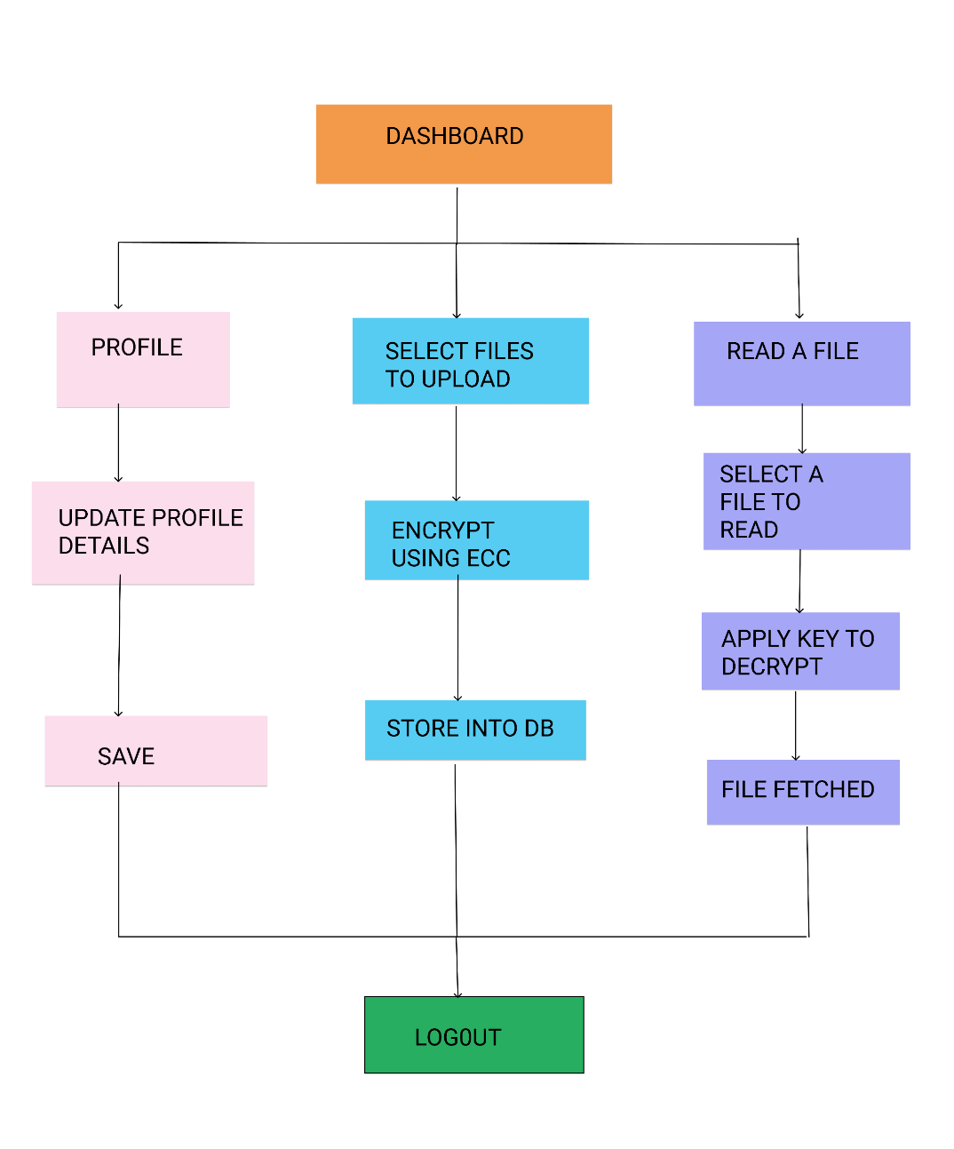
DASHBOARD
It contains three sub-modules
Profile
File upload
Read file and download

Slide 10
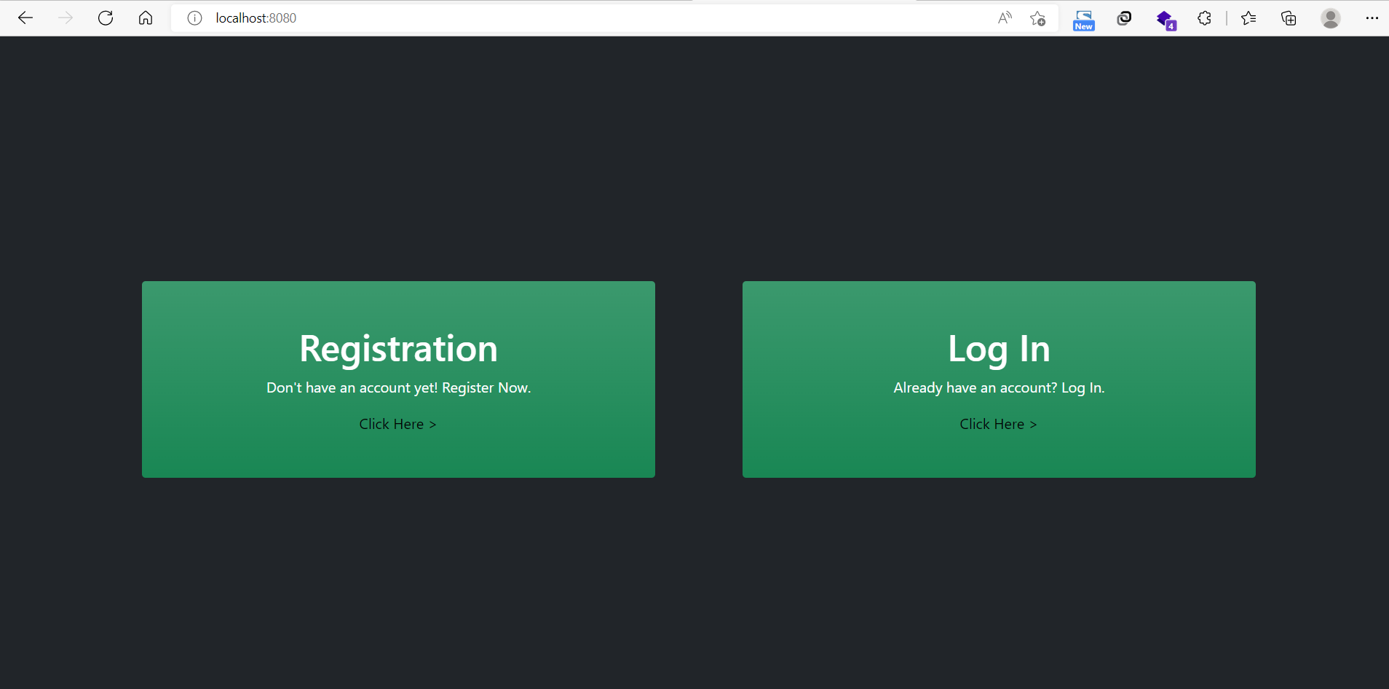
SCREENSHOTS

Slide 11
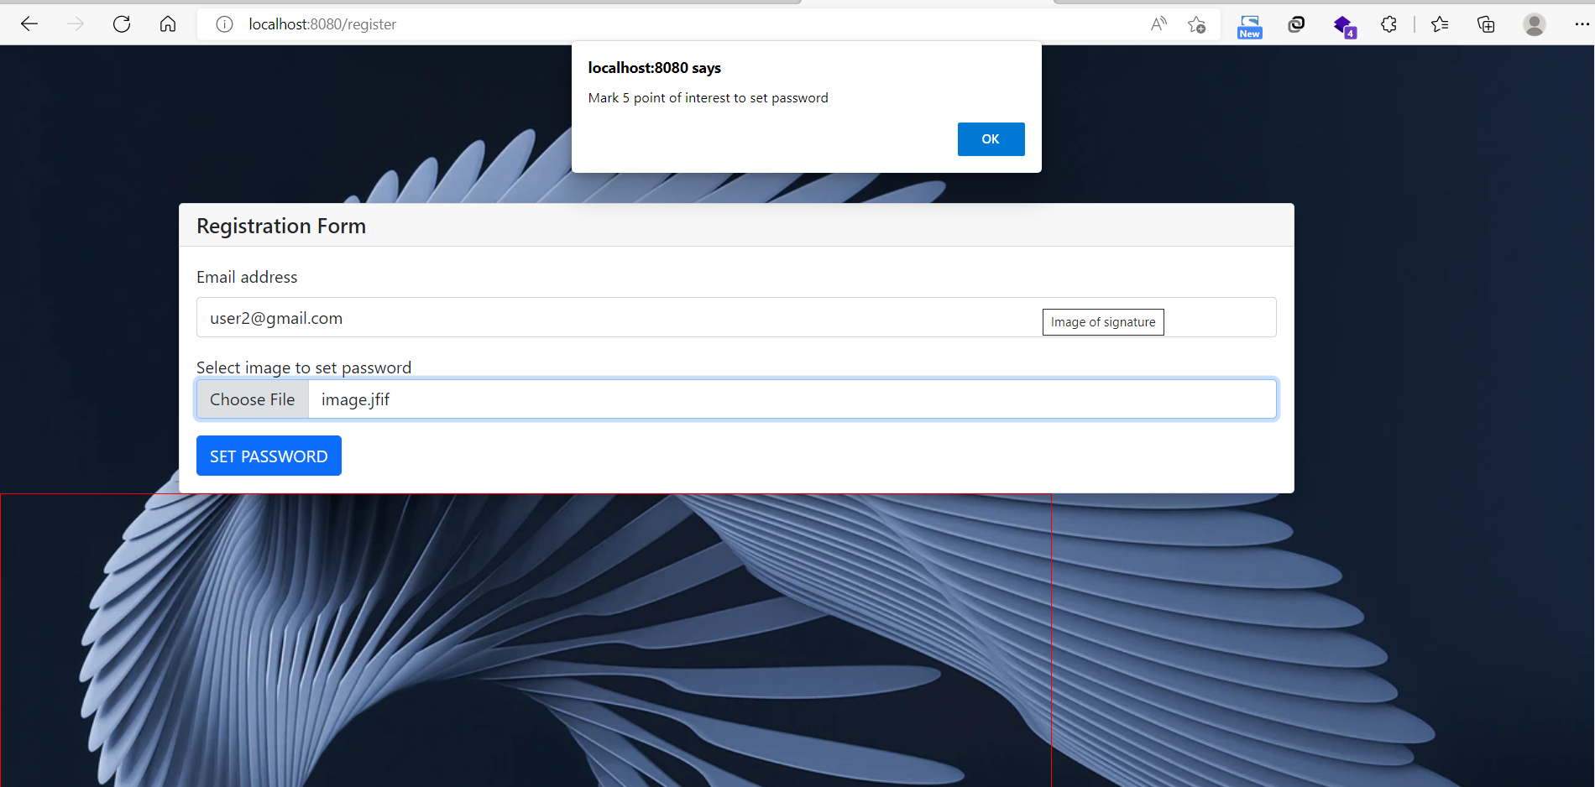
Register page

Slide 12
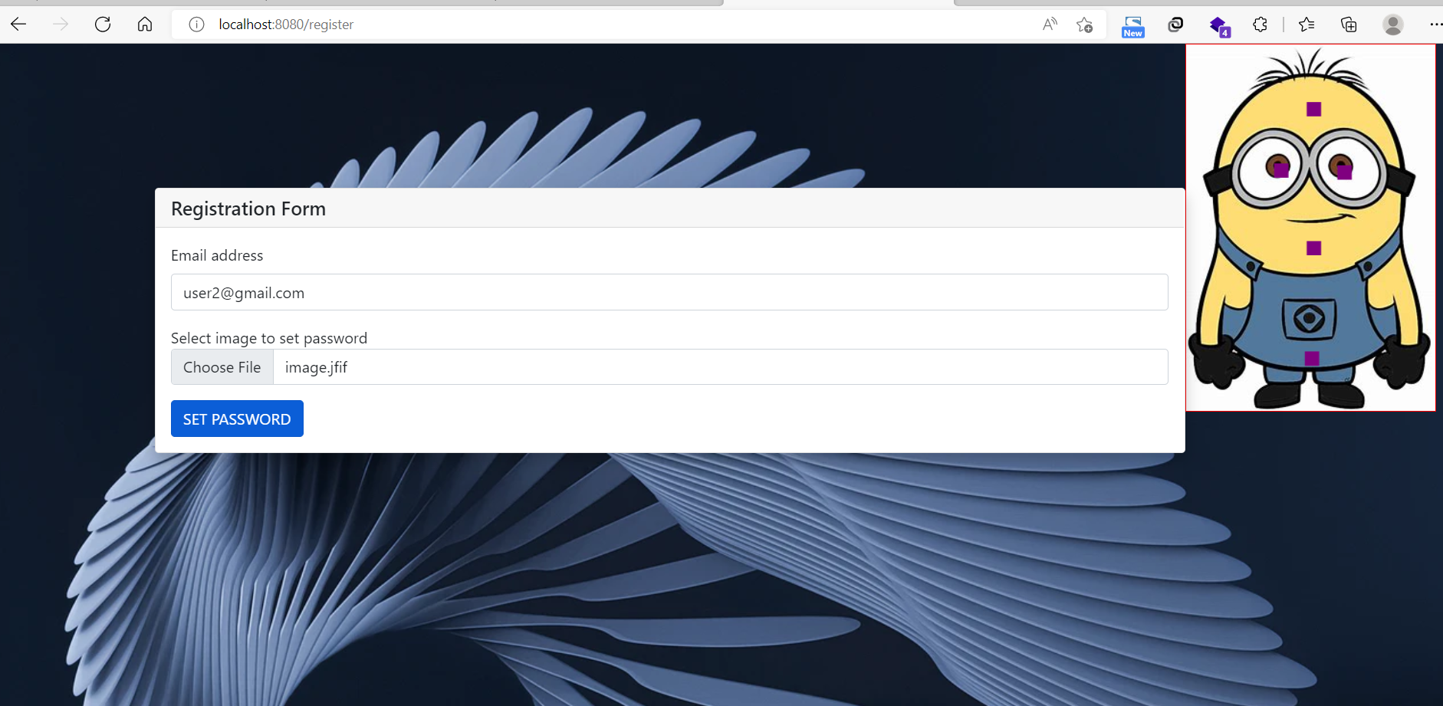
Select an image

Slide 13
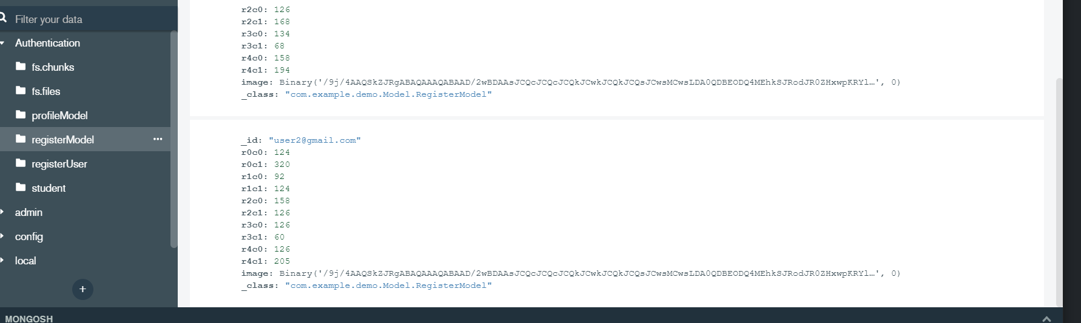
Storing into database

Slide 14
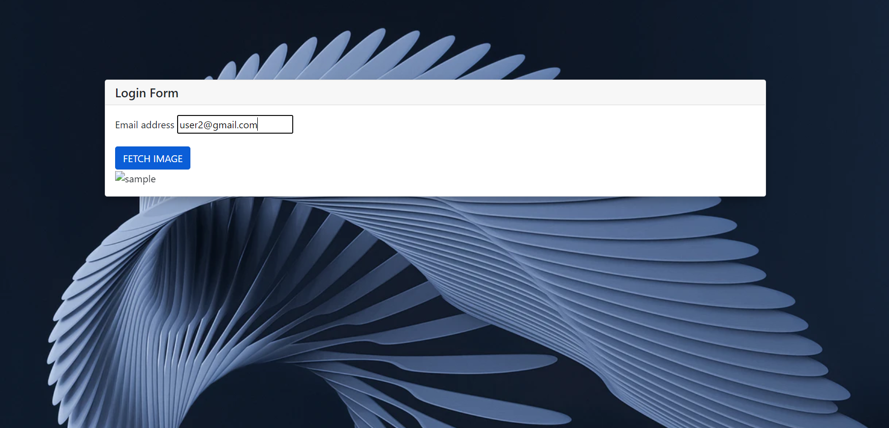
Login page

Slide 15
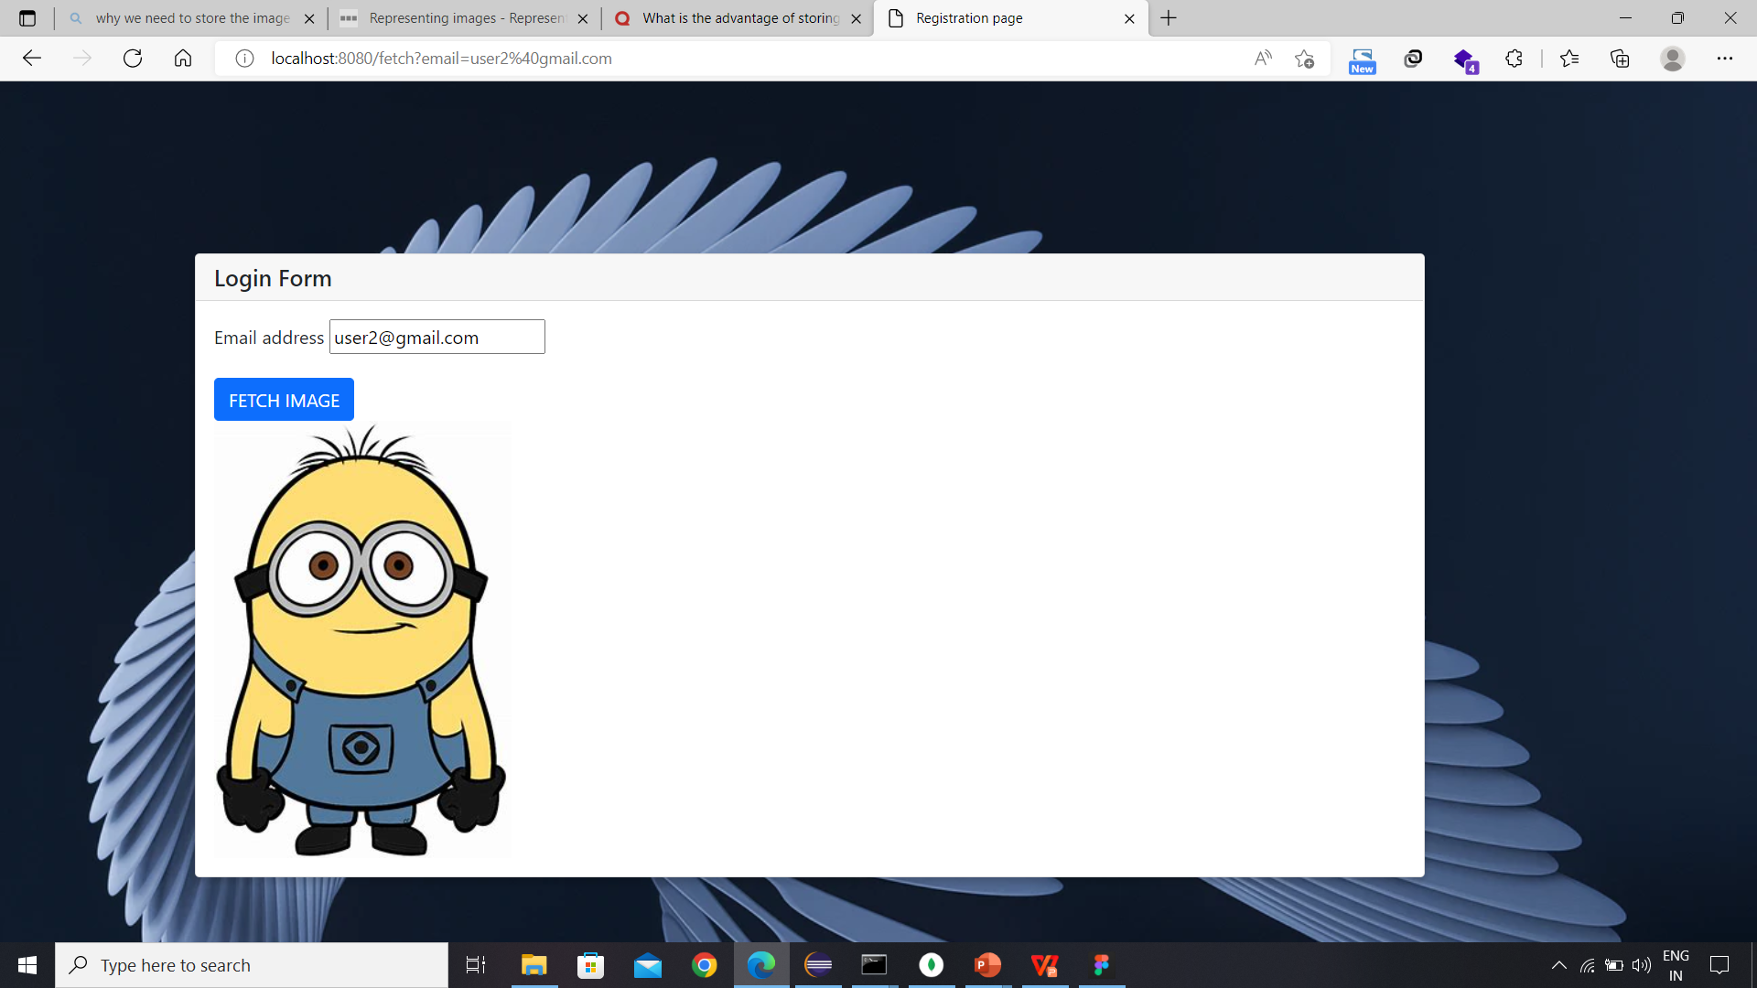

Slide 16
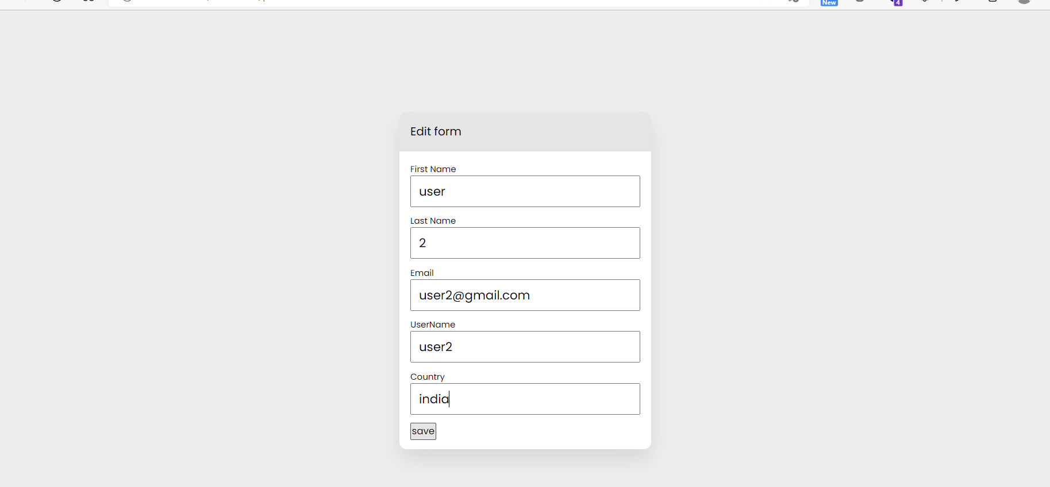
Profile page

Slide 17
REFERENCES
[1] P. C. Golar and B. Khandelwal, "Study of Usability Parameter for Graphical Based Authentication System," 2020 9th International Conference System Modeling and Advancement in Research Trends (SMART), 2020, pp. 23-26, doi: 10.1109/SMART50582.2020.9337116.
[2] H. Arora, G. K. Soni, R. K. Kushwaha and P. Prasoon, "Digital Image Security Based on the Hybrid Model of Image Hiding and Encryption," 2021 6th International Conference on Communication and Electronics Systems (ICCES), 2021, pp. 1153- 1157, doi: 10.1109/IC
[3] http://www.iosrjen.org/Papers/Conf.ICIATE-2018/Volume-6/12-58-60.pdf https://www.irjet.net/archives/V4/i11/IRJET-V4I11330.pdf
[4] C. A. S. Murty, H. Rana, R. Verma, R. Pathak and P. H. Rughani, "A Review of Web Application Security Risks: Auditing and Assessment of the Dark Web," 2021 International Conference on Electrical, Computer, Communications and Mechatronics Engineering (ICEC)

